Slide 1
Computational Techniques 2 Project
Team members:
Reem Ashraf 4.Shahd Medhat
Habeba Ayman 5.Salma Osama
Shrouk Mohamed 6.Rana Mohamed

Slide 2
EscherichiaColiK12_cocomp_hq
1)

Slide 3

Coding

Slide 4
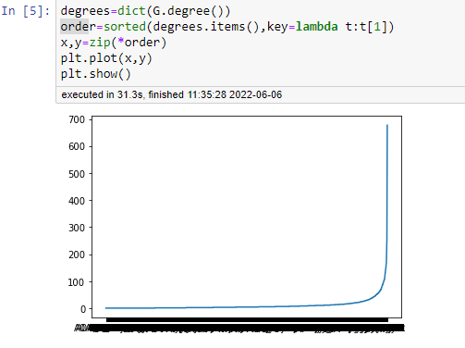
Graph Between Protein & its Degree

Slide 5
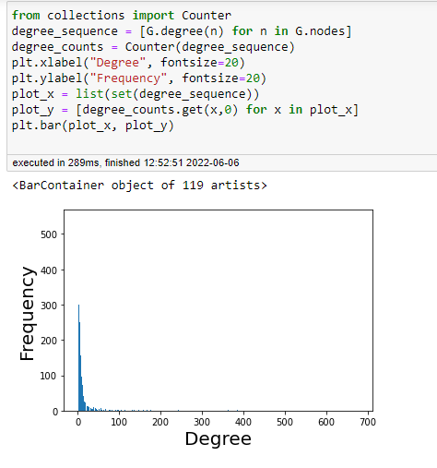
Graph Between Degrees & its Frequency

Slide 6
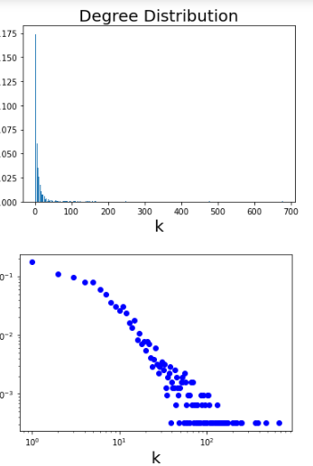
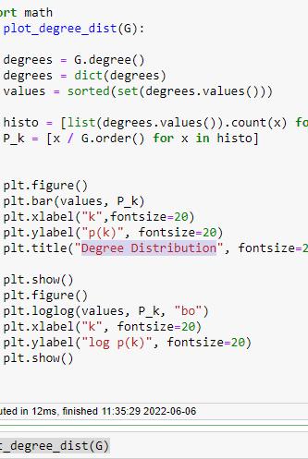
Graphs Of Degree Distribution

Slide 7
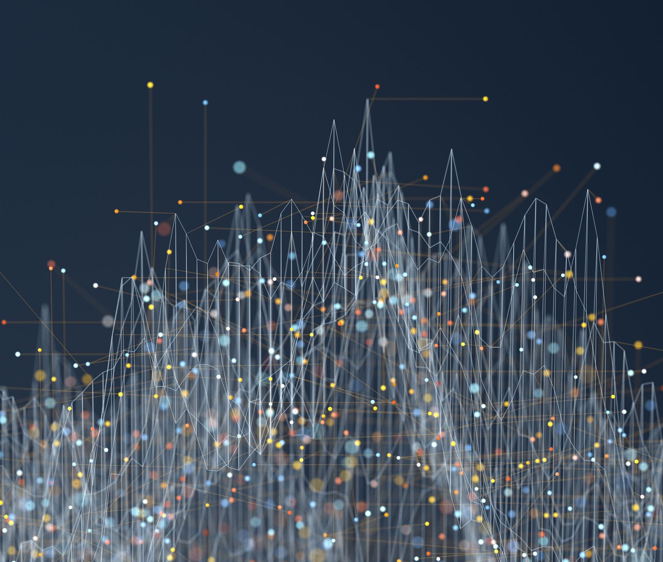
Function Annotation Chart

Slide 8
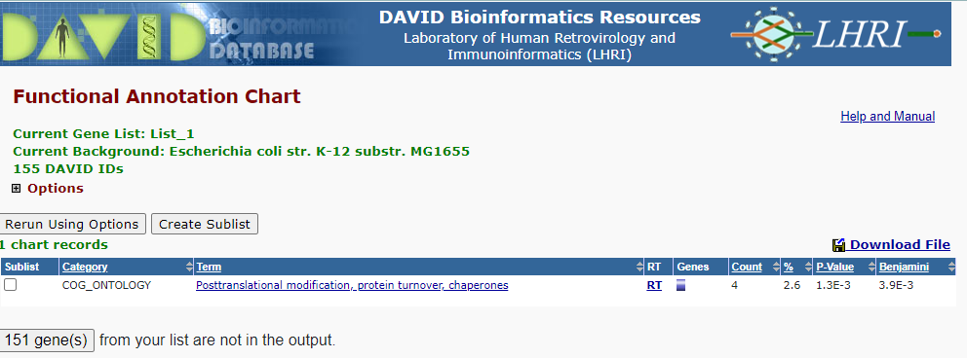
COG_ONTOLOGY

Slide 9
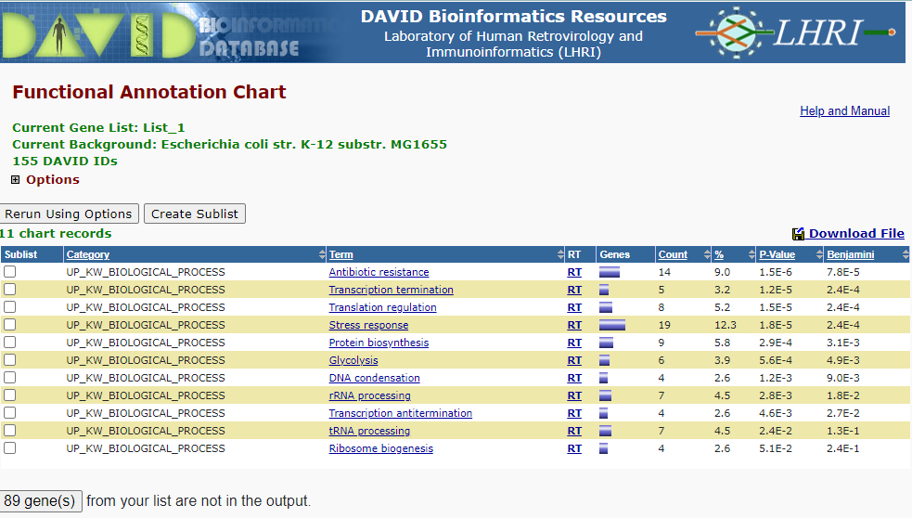
UP_KW_BIOLOGICAL_PROCESS

Slide 10
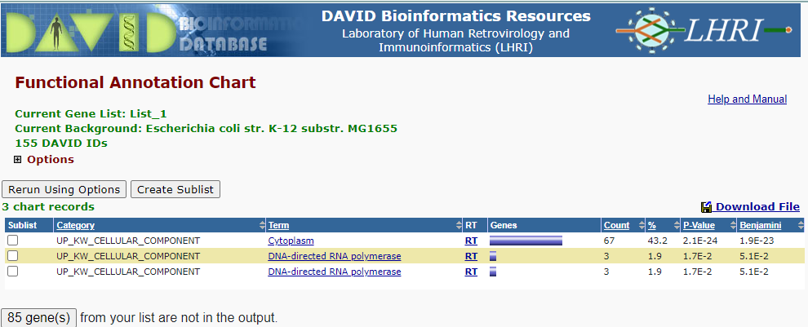
UP_KW_CELLULAR_COMPONENT

Slide 11
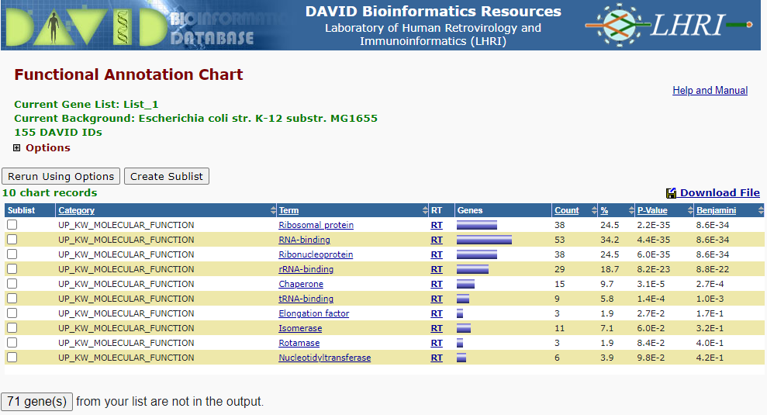
UP_KW_MOLECULAR_FUNCTION

Slide 12
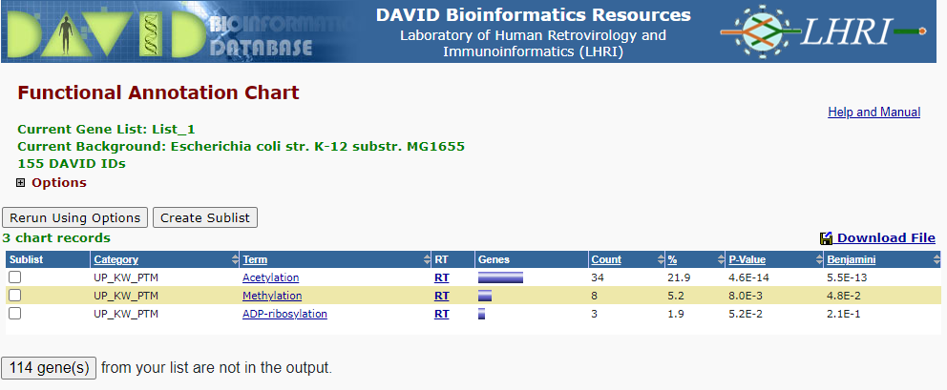
UP_KW_PTM

Slide 13
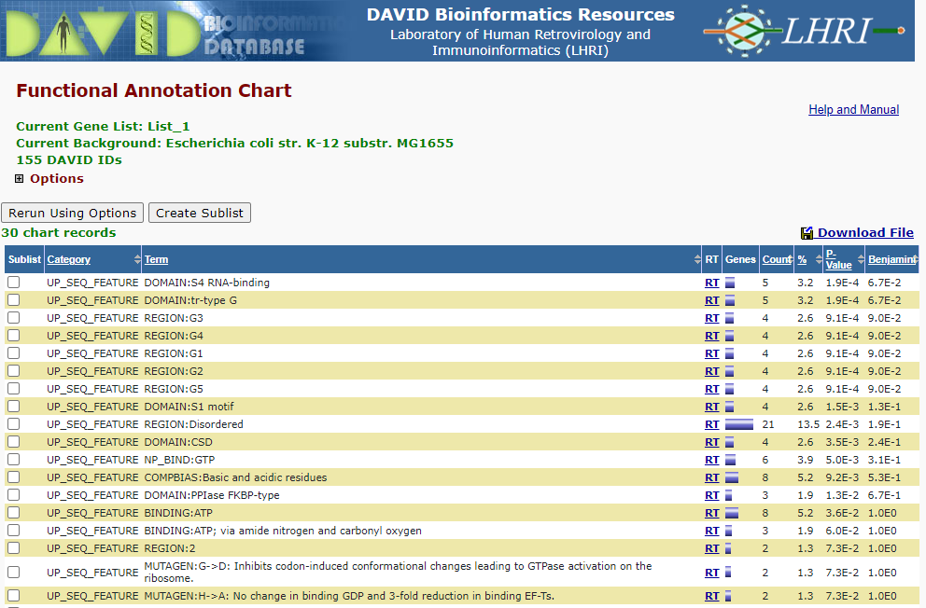
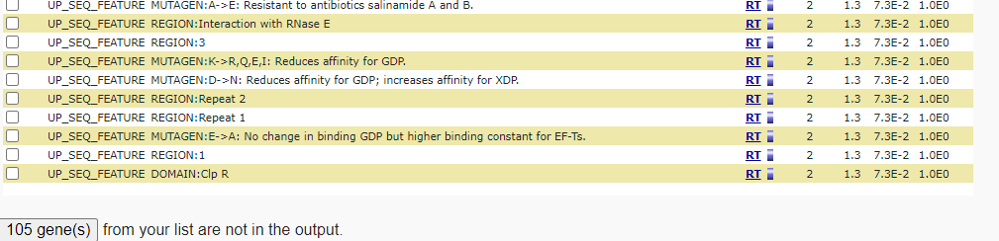
UP_SEQ_FEATURE

Slide 14
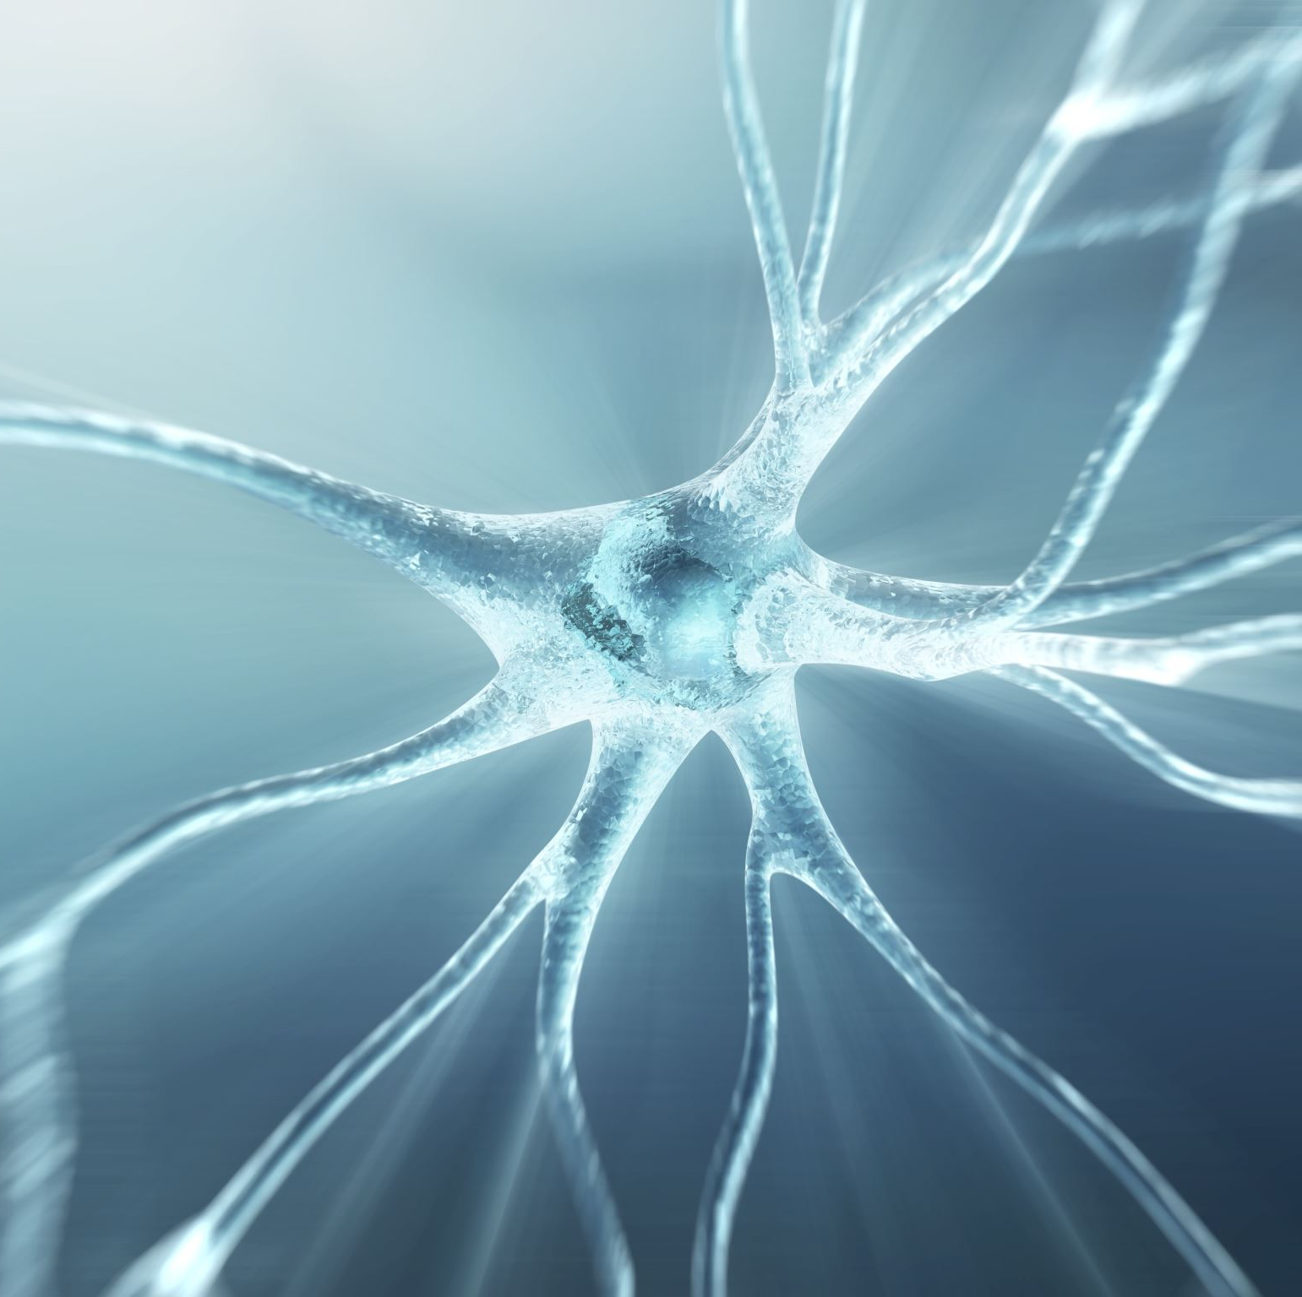
Gene_Ontology

Slide 15
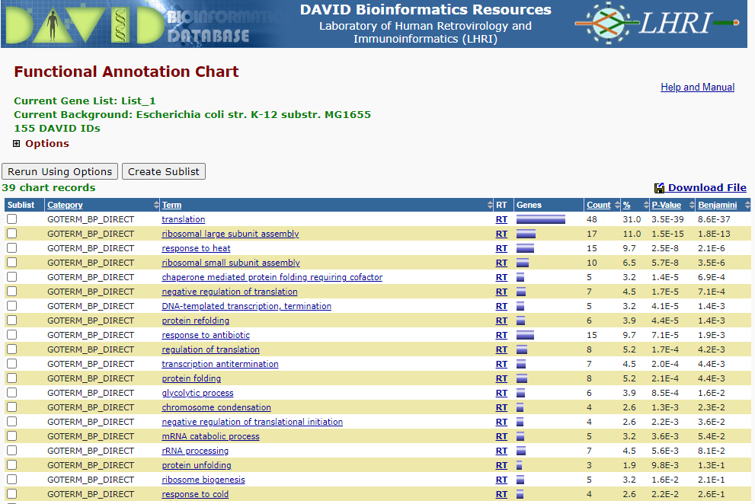
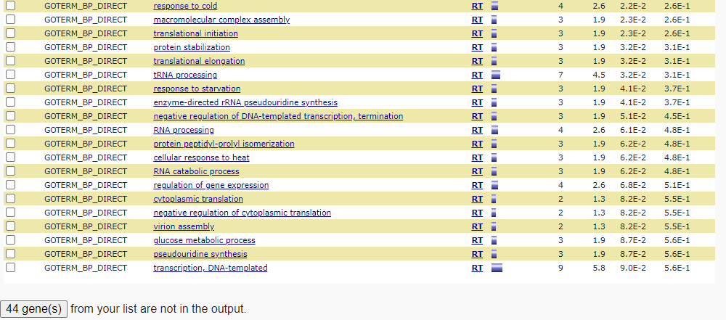
GOTERM_BP_DIRECT

Slide 16
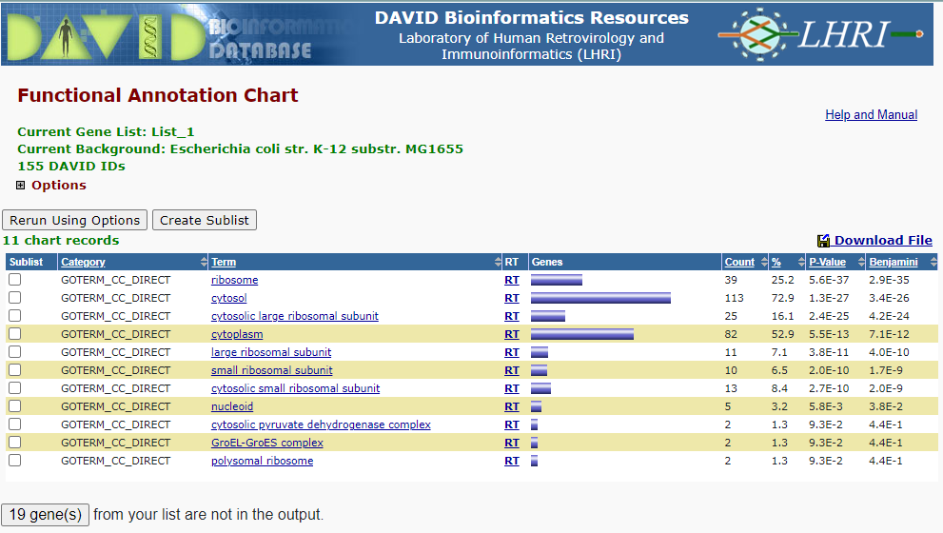
GOTERM_CC_DIRECT

Slide 17
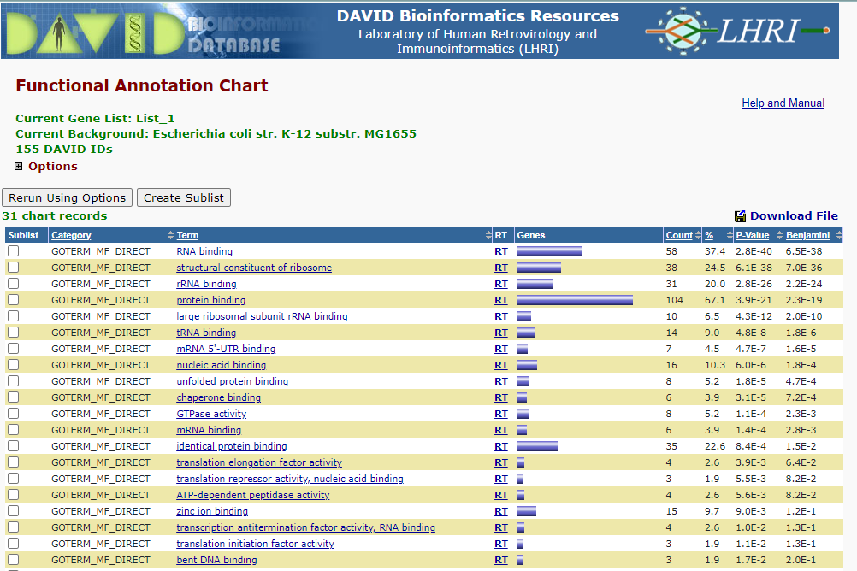
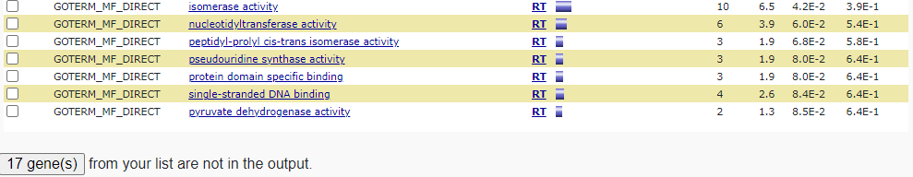
GOTERM_MF_DIRECT

Slide 18

Interactions

Slide 19
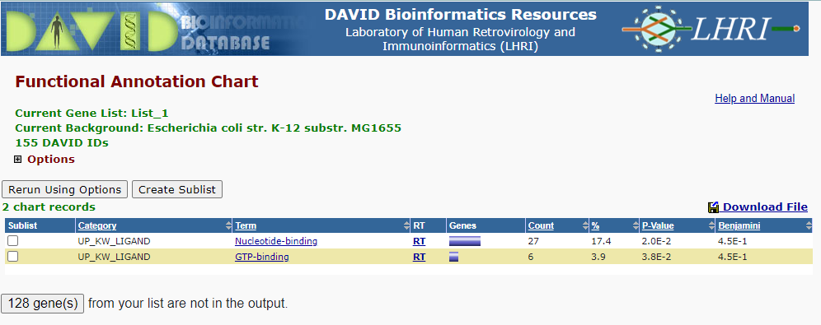
UP_KW_LIGAND

Slide 20

Pathways

Slide 21
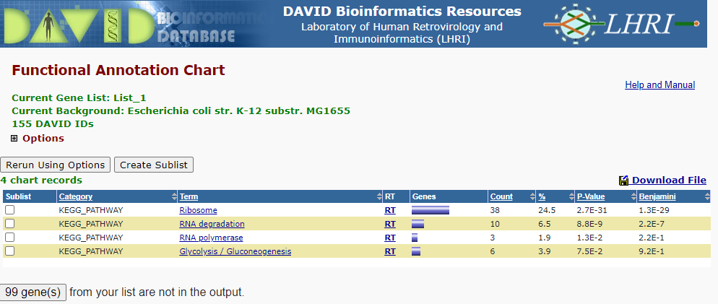
KEGG_PATHWAY

Slide 22
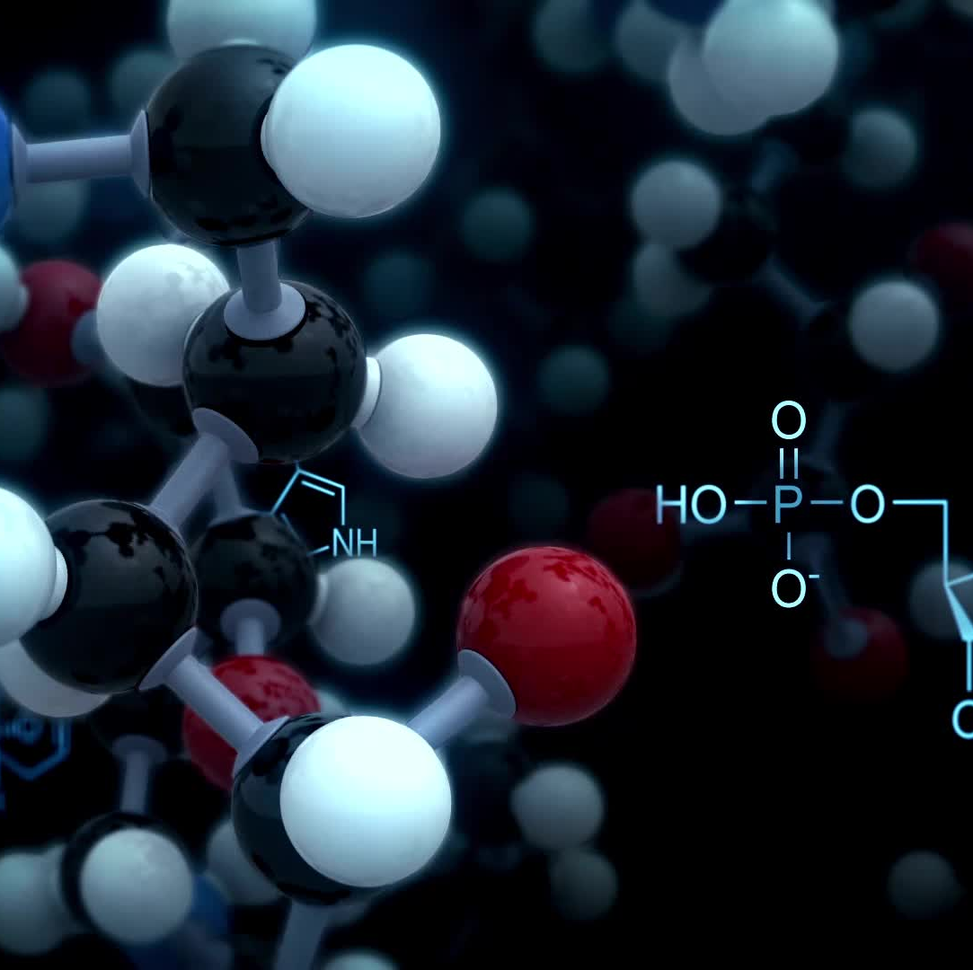
Protein_Domains

Slide 23
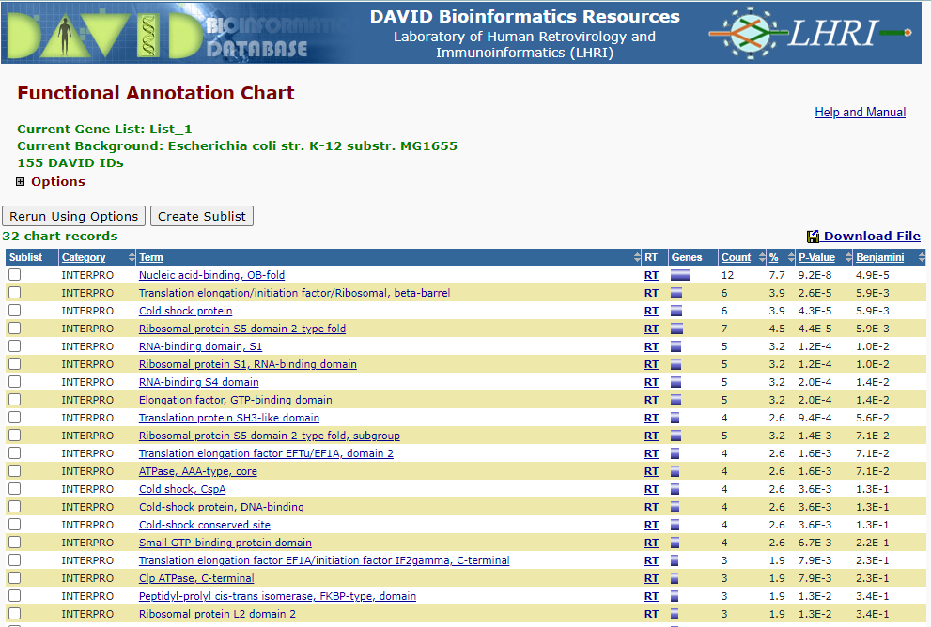
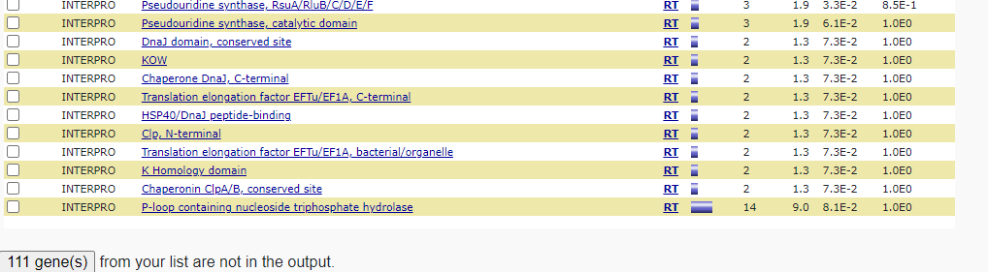
INTERPRO

Slide 24
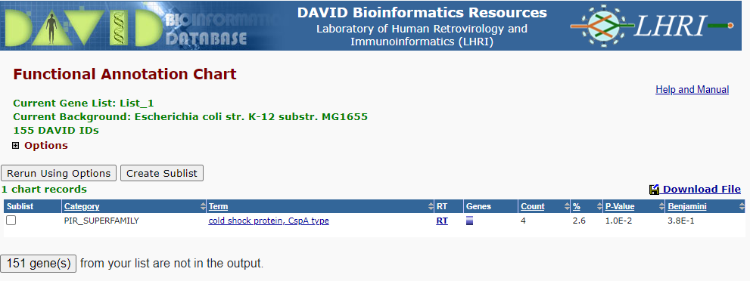
PIR_SUPERFAMILY

Slide 25
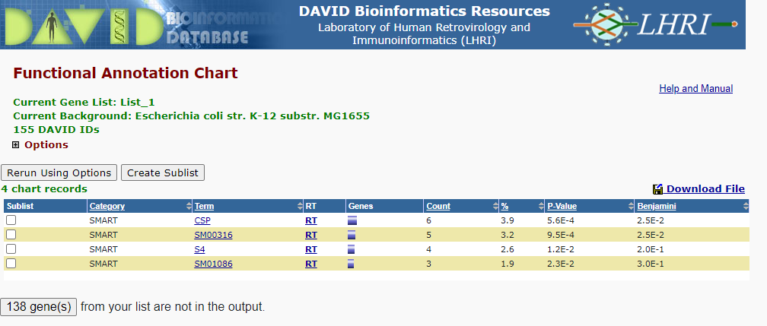
SMART

Slide 26
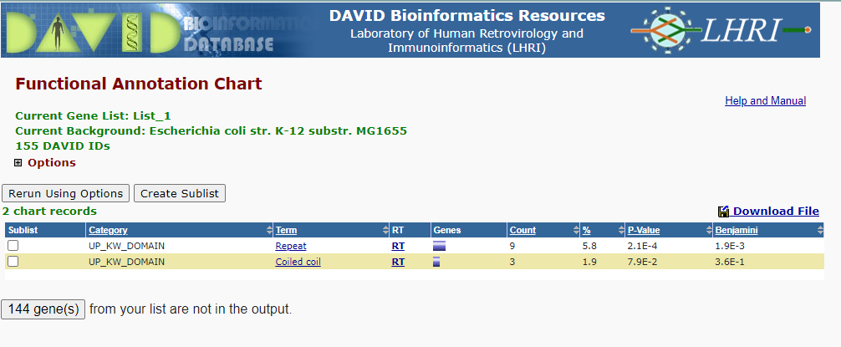
UP_KW_DOMAIN

Slide 27
DrosophilaMelanogaster_lcc_hq
2)

Slide 28
Coding

Slide 29
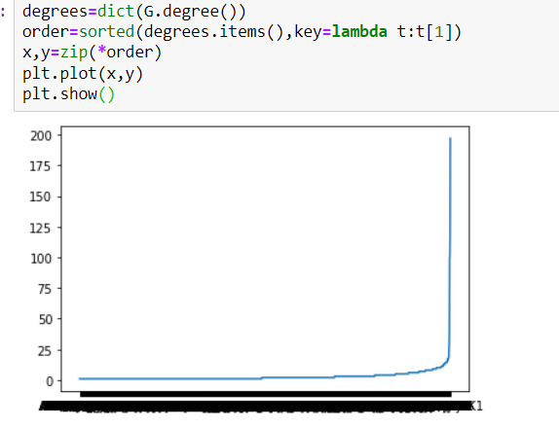
Graph Between Protein & its Degree

Slide 30
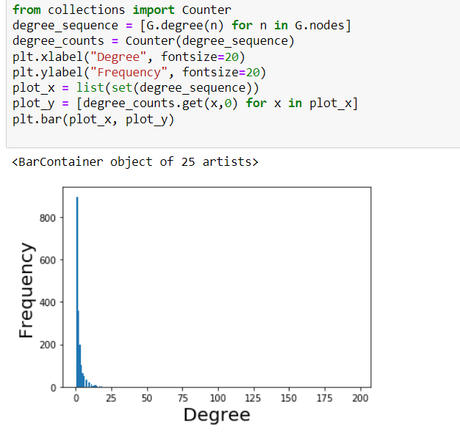
Graph Between Degrees & its Frequency

Slide 31
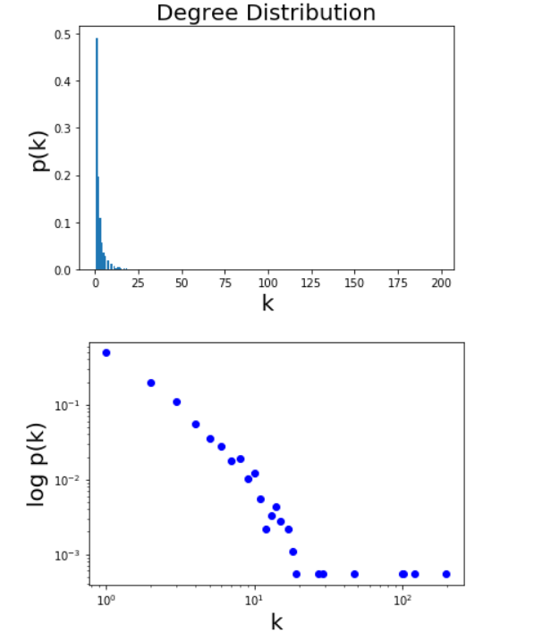
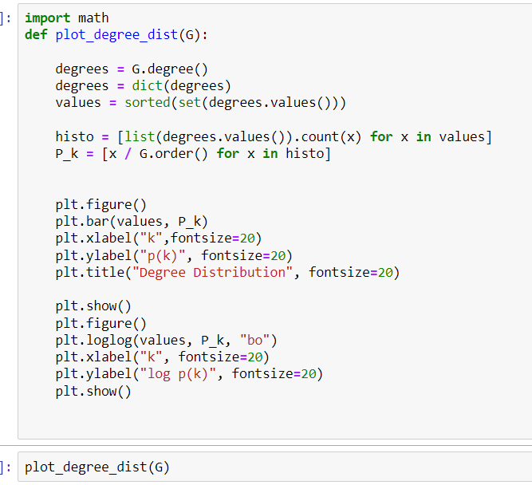
Graphs Of Degree Distribution

Slide 32
Function Annotation Chart

Slide 33
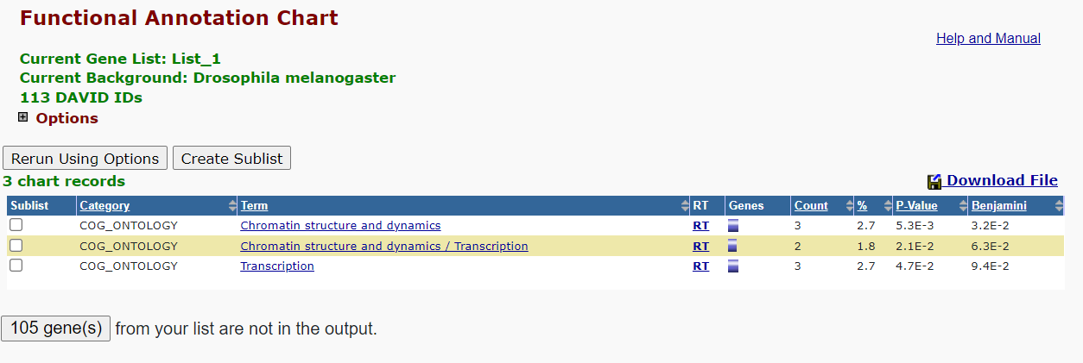
COG_ONTOLOGY

Slide 34
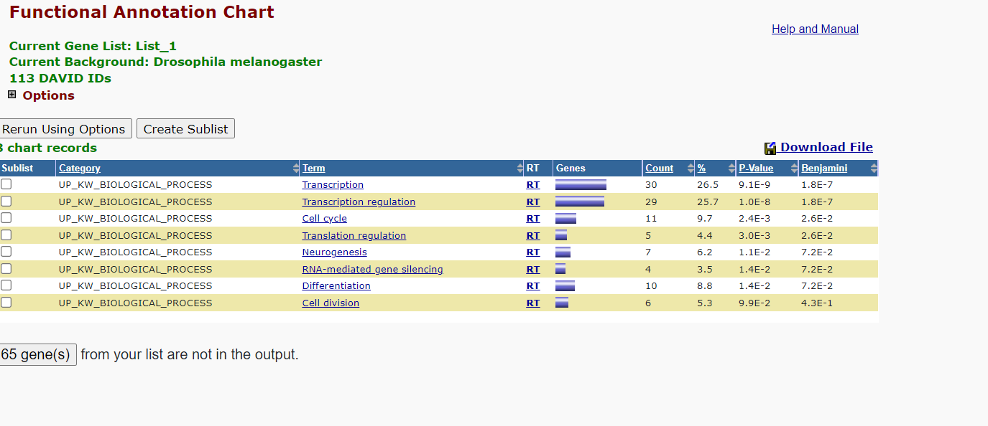
UP_KW_BIOLOGICAL_PROCESS

Slide 35
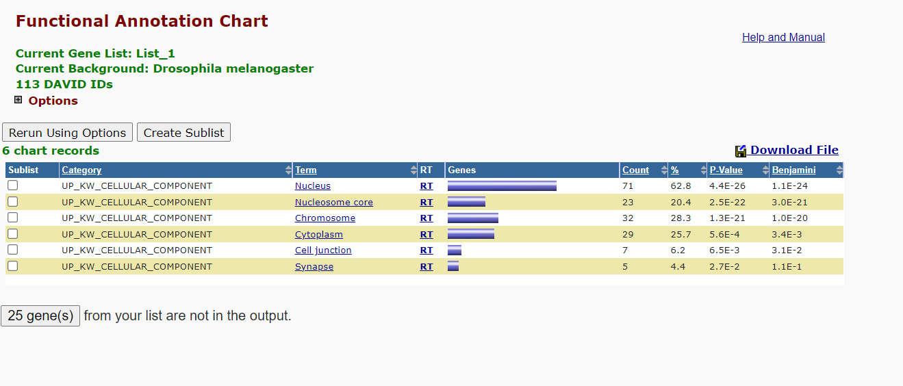
UP_KW_CELLULAR_COMPONENT

Slide 36
UP_KW_MOLECULAR_FUNCTION

Slide 37
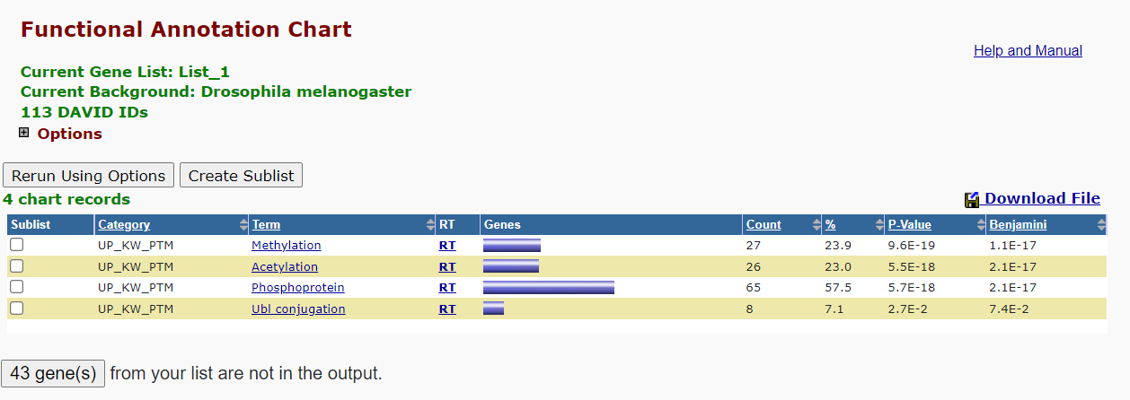
UP_KW_PTM

Slide 38
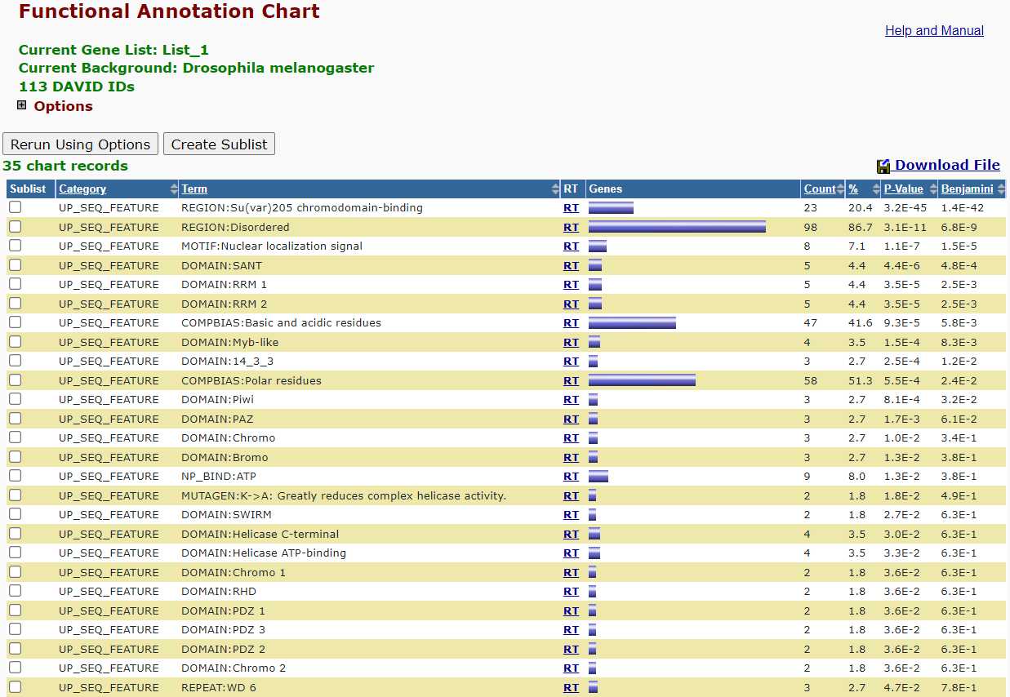
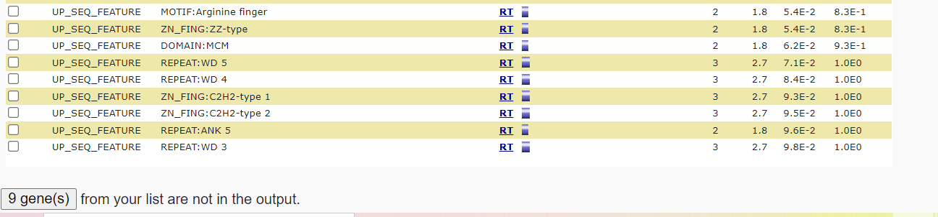
UP_SEQ_FEATURE

Slide 39
Gene_Ontology

Slide 40
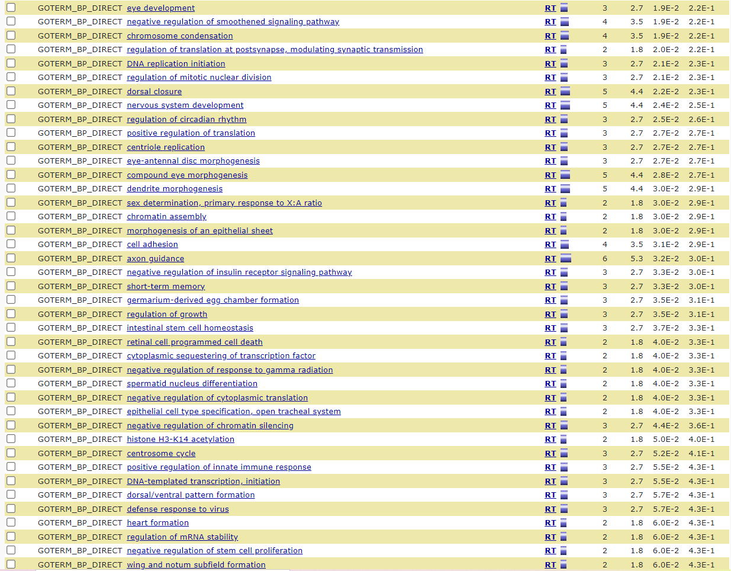
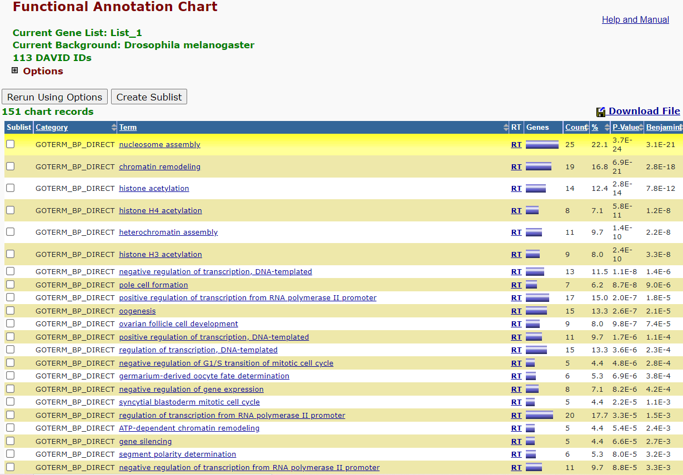
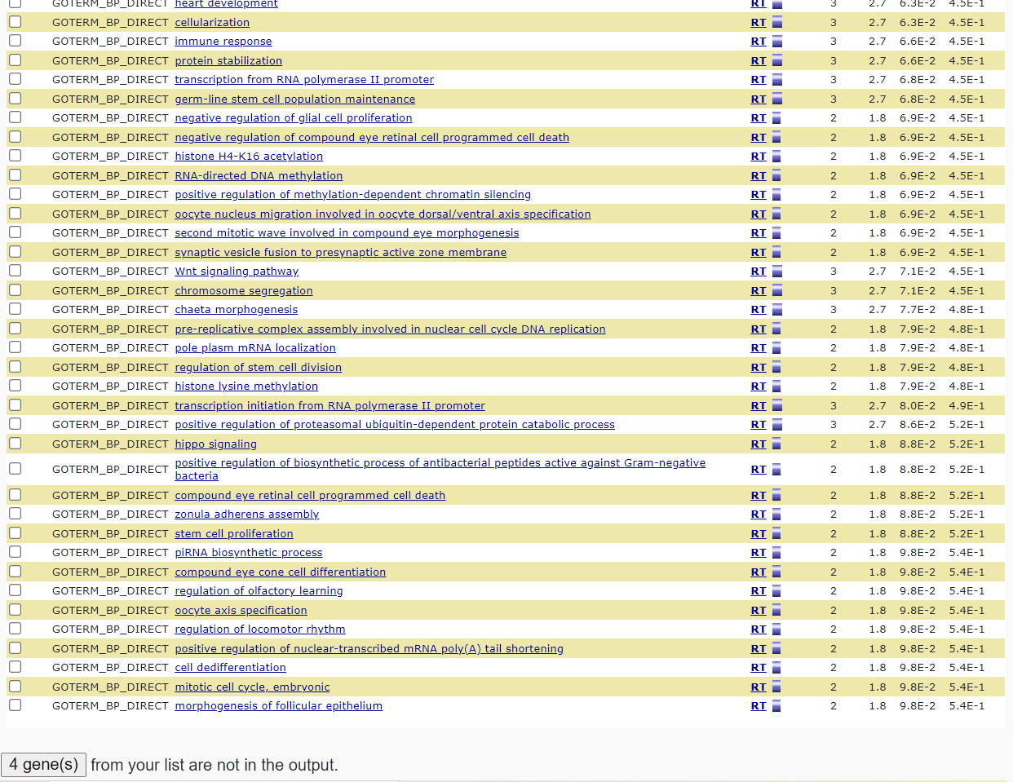
GOTERM_BP_DIRECT

Slide 41
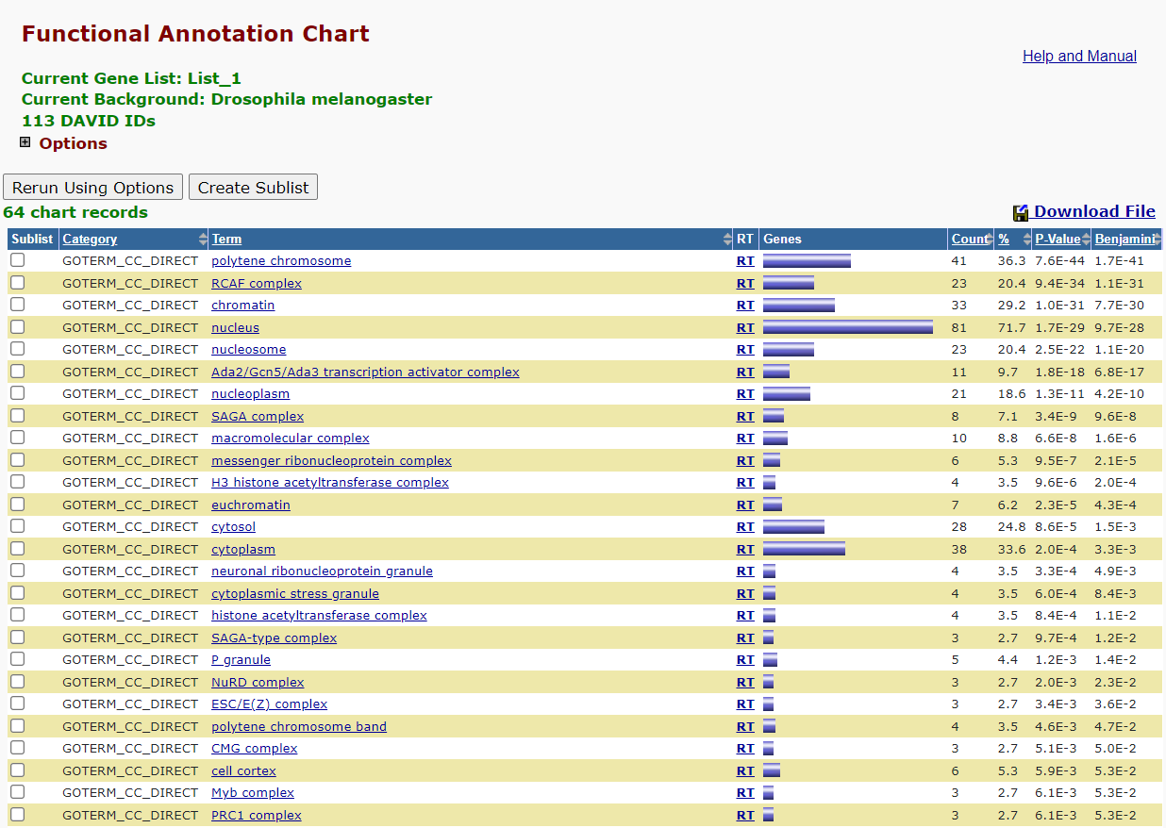
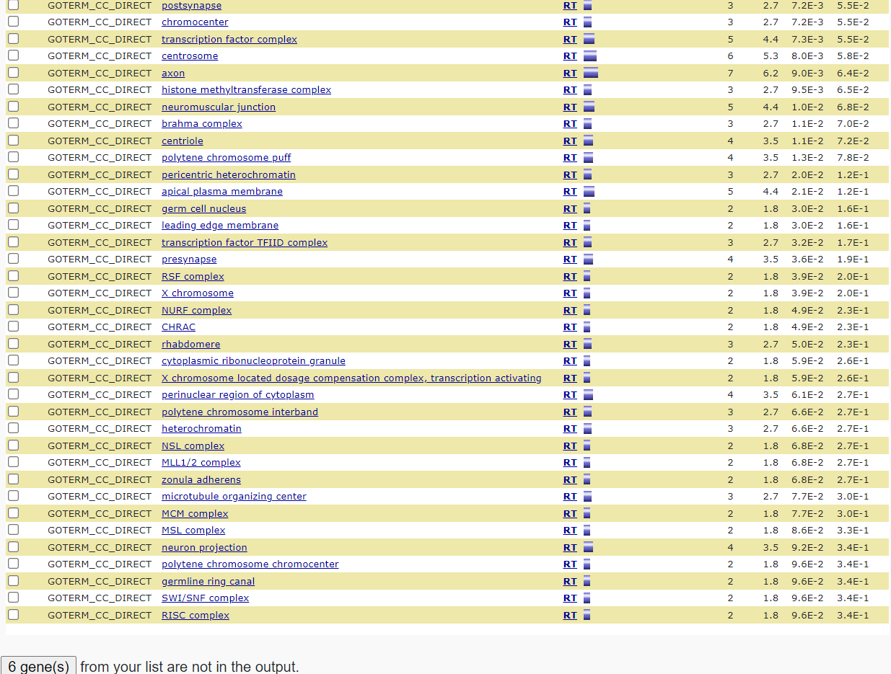
GOTERM_CC_DIRECT

Slide 42
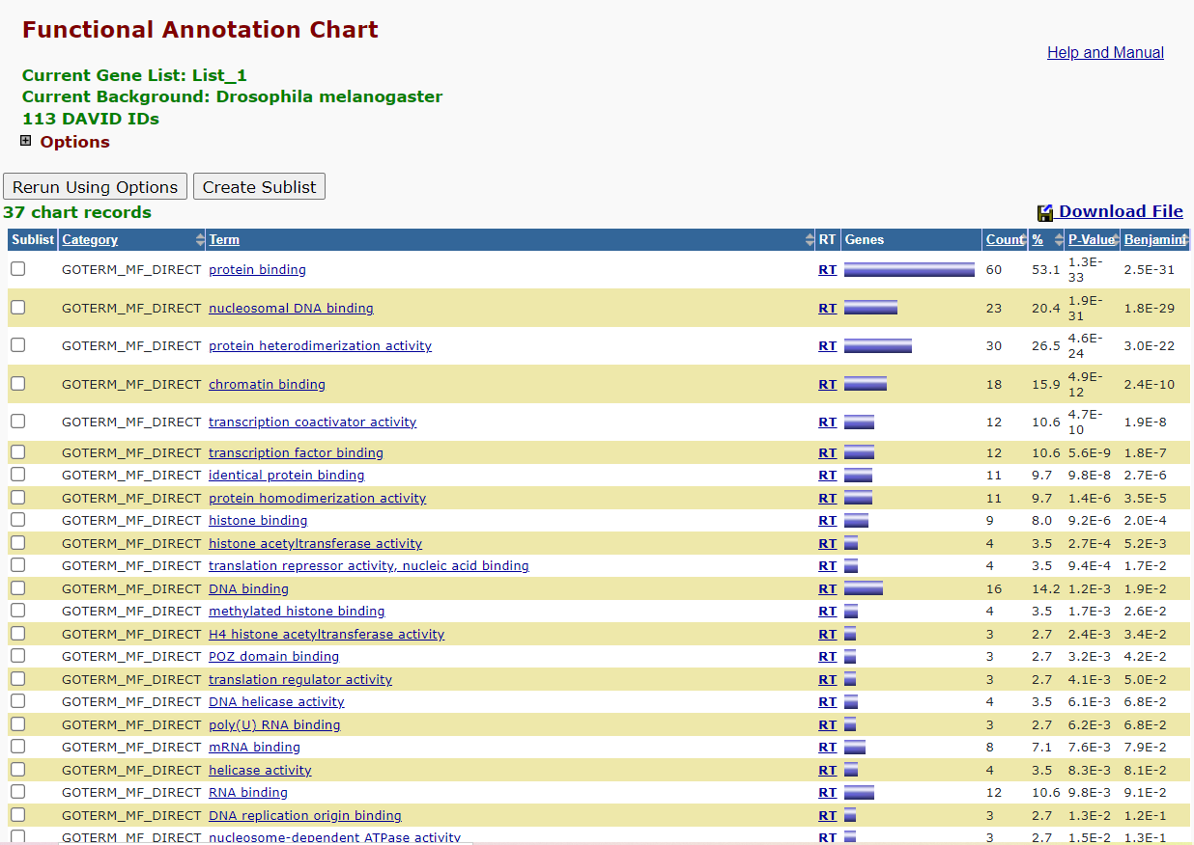
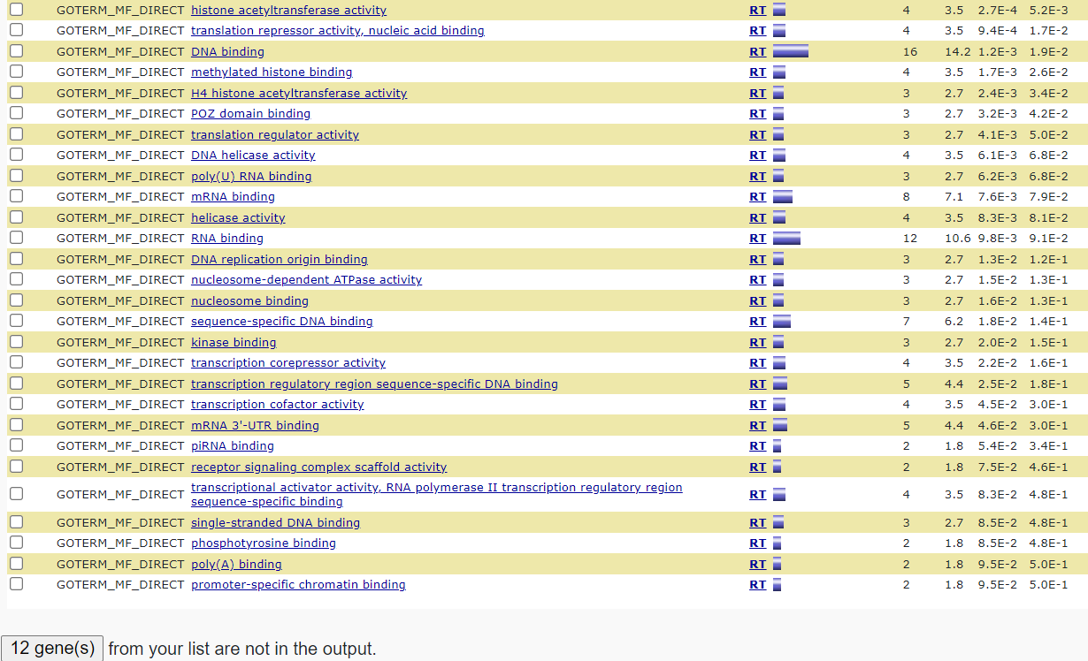
GOTERM_MF_DIRECT

Slide 43
Interactions

Slide 44
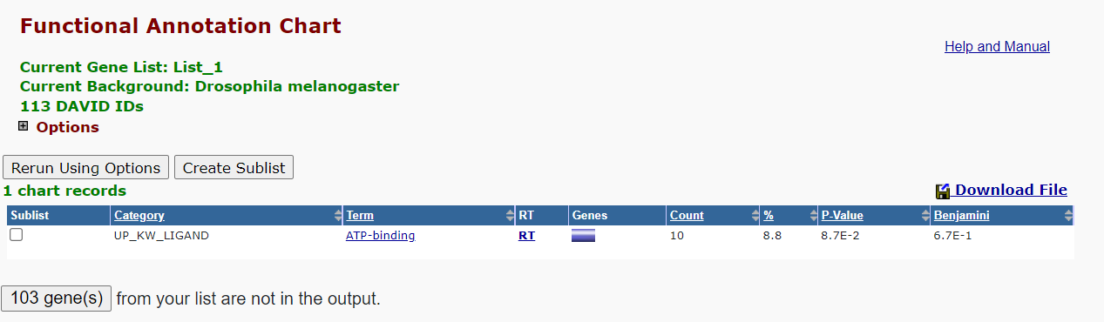
UP_KW_LIGAND

Slide 45
Pathways

Slide 46
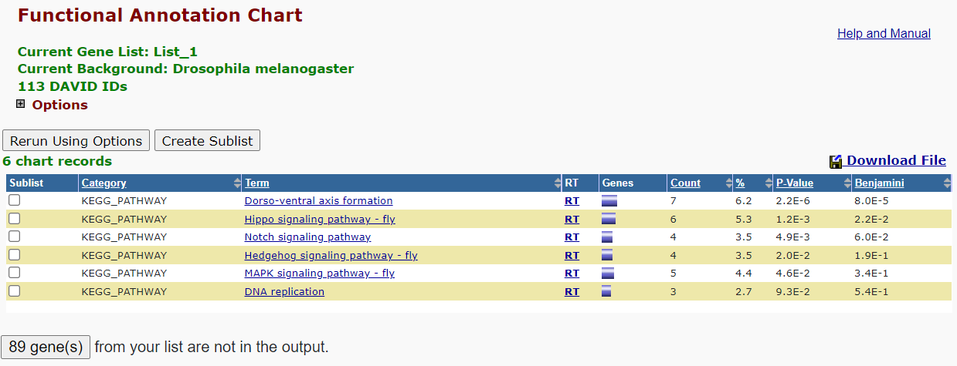
KEGG_PATHWAY

Slide 47
Protein_Domains

Slide 48
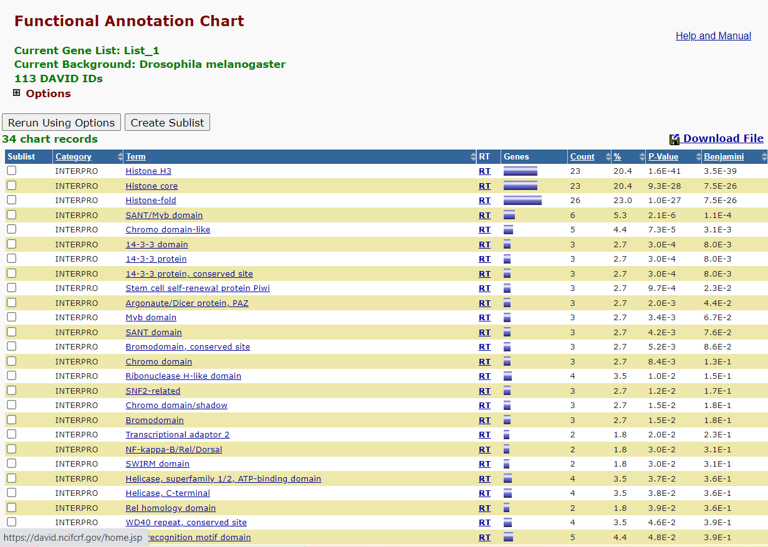
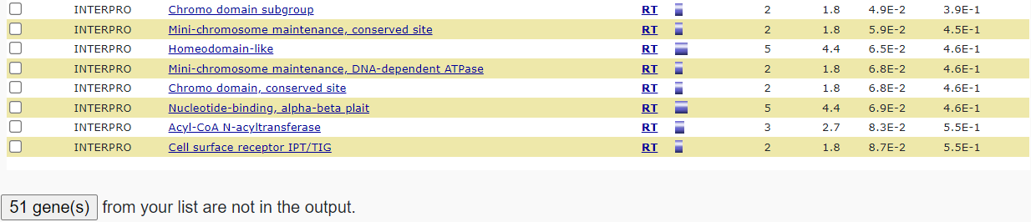
INTERPRO

Slide 49
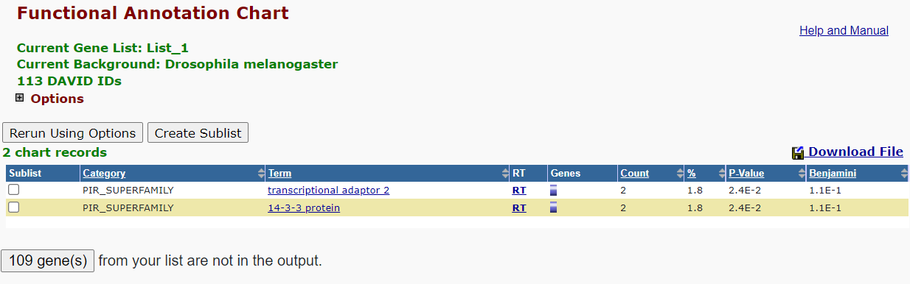
PIR_SUPERFAMILY

Slide 50
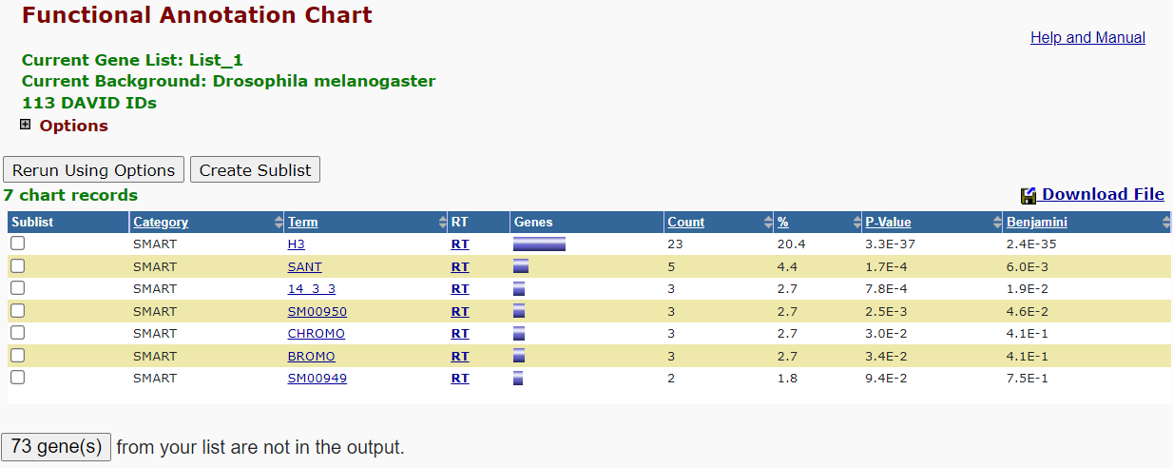
SMART

Slide 51
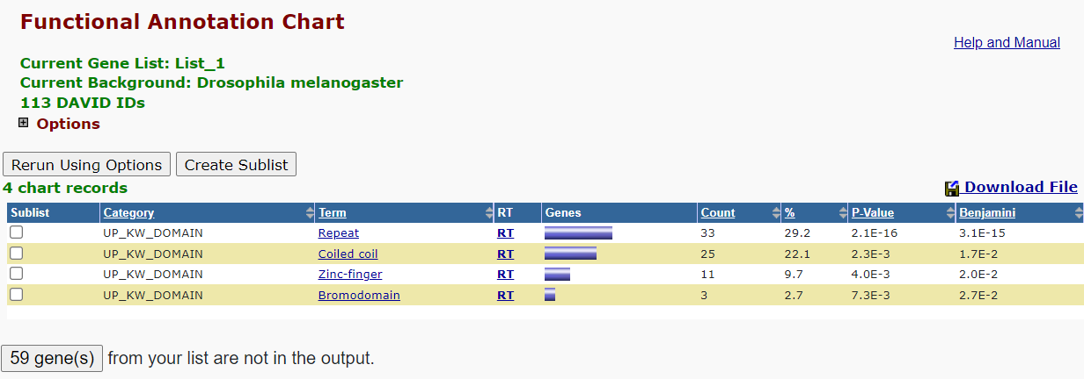
UP_KW_DOMAIN

Slide 52
HomoSapiens_cocomp_all
3)

Slide 53
Coding

Slide 54

Graph Between Protein & its Degree

Slide 55

Graph Between Degrees & its Frequency

Slide 56

Graphs Of Degree Distribution

Slide 57
Function Annotation Chart

Slide 58

COG_ONTOLOGY

Slide 59

UP_KW_BIOLOGICAL_PROCESS

Slide 60

UP_KW_CELLULAR_COMPONENT

Slide 61

UP_KW_MOLECULAR_FUNCTION

Slide 62

UP_KW_DISEASE

Slide 63

UP_SEQ_FEATURE

Slide 64
Gene_Ontology

Slide 65

GOTERM_BP_DIRECT

Slide 66

GOTERM_CC_DIRECT

Slide 67

GOTERM_MF_DIRECT

Slide 68
Interactions

Slide 69

UP_KW_LIGAND

Slide 70
Pathways

Slide 71

KEGG_PATHWAY

Slide 72

BIOCARTA

Slide 73

BRID

Slide 74
Protein_Domains

Slide 75

INTERPRO

Slide 76

PIR_SUPERFAMILY

Slide 77

SMART

Slide 78

UP_KW_DOMAIN

